Slide 1
CARBON MARKETING
ROLE OF AI

Slide 2
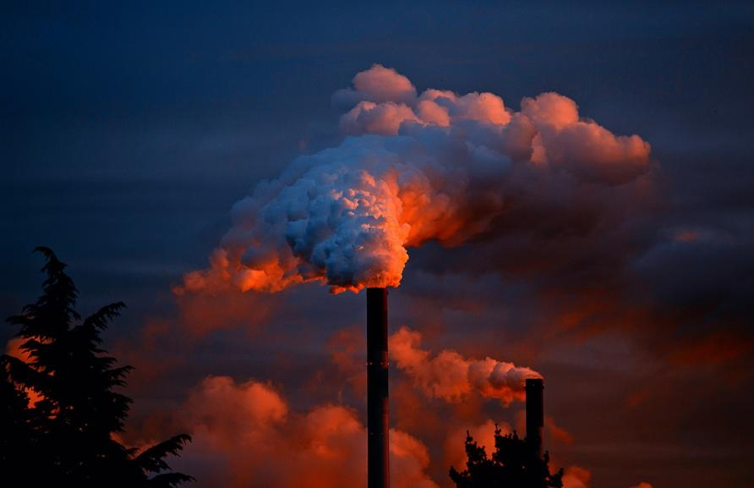
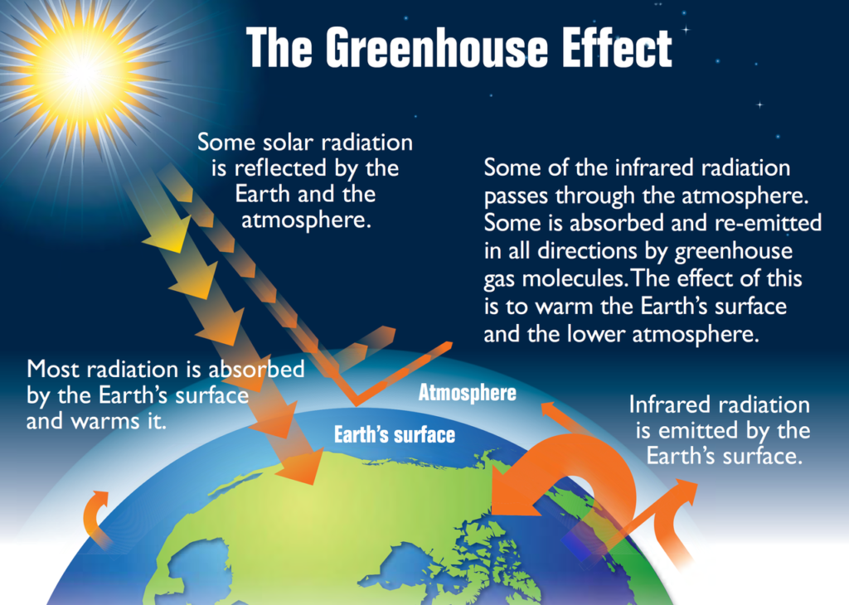
GREENHOUSE GAS
Greenhouse gases(Co2) are the gases that trap heat in the atmosphere. These are the gases causing greenhouse effect . These gases absorb and emit radiant energy in the thermal infrared range thus leading to the green house effect.
Greenhouse effect is the process by which (infrared)radiations from the sun are absorbed by the greenhouse gases & not reflected back into the space .This insulates the surface of the earth and prevents it from freezing.
This Photo by Unknown Author is licensed under CC BY-ND
This Photo by Unknown Author is licensed under CC BY-SA

Slide 3
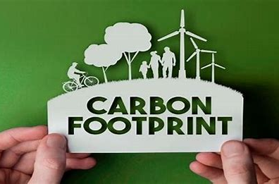
CARBON FOOTPRINT
A carbon footprint is the total greenhouse gas emission caused by an individual, event, organisation or product. It is usually expressed in equivalent tons of Co2.The carbon footprint is way to measure the impact of human activities in the environment.

Slide 4
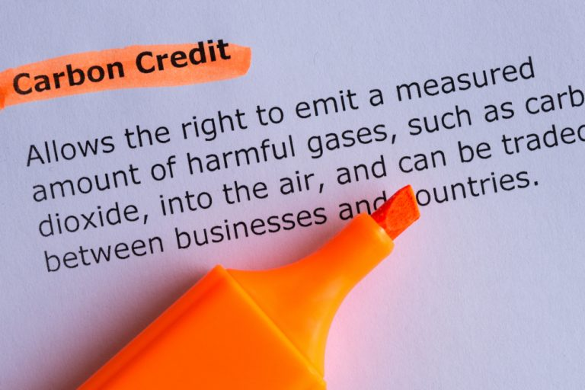
Carbon credit are permit that allow the owner to emit a certain amount of Co2 or other greenhouse gases . It devised as a mechanism to reduce greenhouse gas emission . It create a monetary incentive for companies to reduce their carbon emission.
Carbon credit are a key component of international & national emissions trading scheme that have been implemented to mitigate global warming. Carbon credit awarded to countries or groups that have reduced greenhouse gas below their emission quota . Company get set number of credits , which decline overtime and they can sell any excess to another company.
1 Credit -> 1 ton Co2 (emission)

Slide 5
CARBON MARKETING Carbon markets are trading systems in which carbon credits are sold & bought. When a credit use to reduce , sequester or avoid emission , it becomes an offset and is no longer tradeable. There are two types of carbon market :- 1.Compliance market 2.Voluntary market
Companies and individuals can use carbon markets to compensate for their GH emission by purchasing carbon credit from entities that remove or reduce greenhouse gas emission. carbon markets are a fundamental tool to accelerate investments into nature and are critical to comprehensive climate action . The carbon markets have been recognized as one of the critical instruments to mobilize and ease private capital flows into high-quality nature activities . If harnessed correctly, the carbon market can enable organizations and companies to credibly enact their global operations and also supporting the restoration of nature.

Slide 6
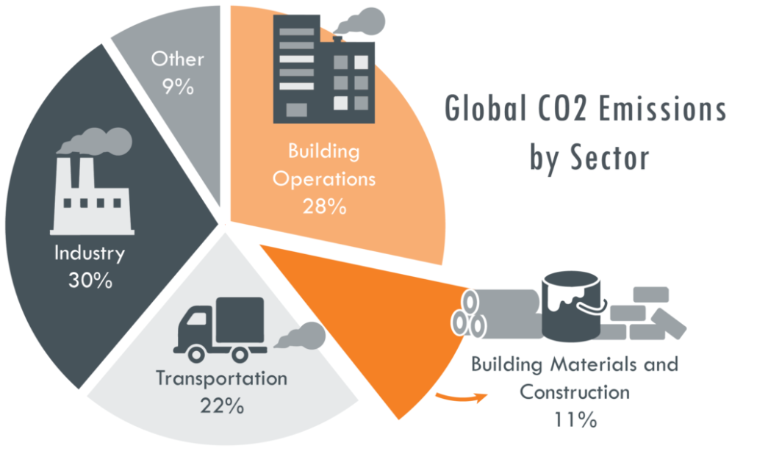
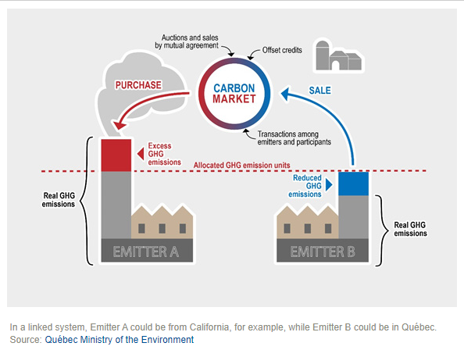
DIAGRAMATIC VIEW

Slide 7
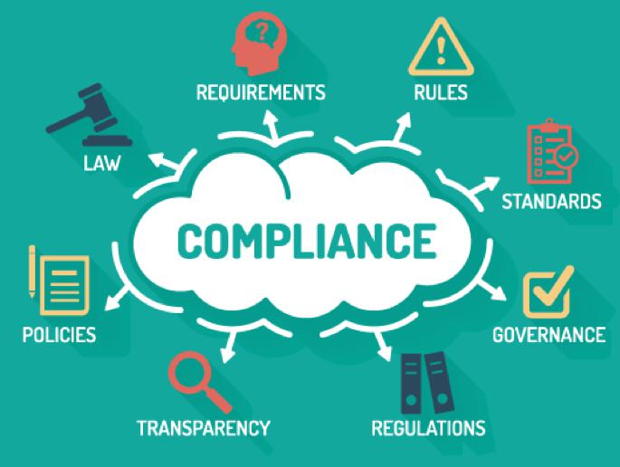
COMPLIANCE MARKET
Compliance markets are created as a result of any national , regional and/or international policy or regulatory requirement .
The ETS, overseen by the California Air Resources Board , is an example of a compliance market . Because these are highly regulated and carbon credit are both created by (& overseen by) the same organization, there is considerable standardization.
In a Cap & Trade system, a corresponding compliance market exists where the quality & the credibility of carbon credits are consistent and high.
Other examples Union emissions trading system :- Kyoto Protocol , the European Union/Australia/British(Columbia)/New Zealand emissions trading system .

Slide 8
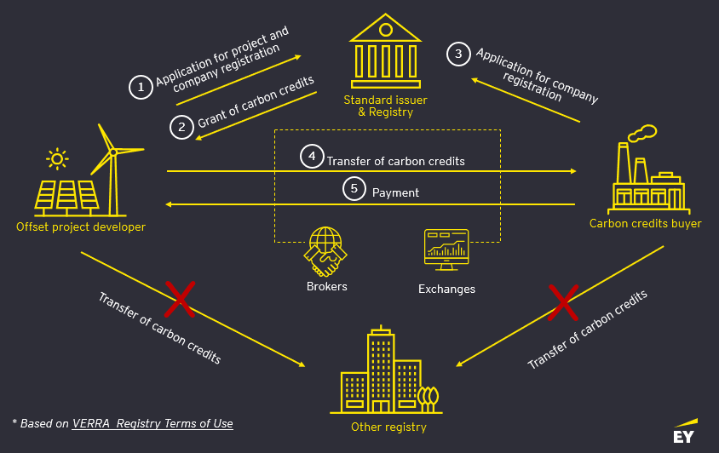
VOLUNTARY MARKET
-national & international – refer to the issuance , buying and selling of carbon credits , on a voluntary basis . The current supply of voluntary carbon credits comes mostly from private entities that develop carbon projects , or government that develop programs certified by carbon standards that generates emissions reductions/ removals . Demand comes from private individual that want to compensate for their carbon footprints , corporations with corporate sustainability targets , and other actors aiming to trade credits at a higher price to make a profit.
These markets are subject to considerably less regulation & oversight . Voluntary markets exist not to trade carbon credits but so that participants can create and trade carbon offsets , which are quite different.
Examples are the Carbon Offsetting and Reduction Scheme for International Aviation (CORSIA), which was set by the aviation sector to offset its GHG emissions .

Slide 9
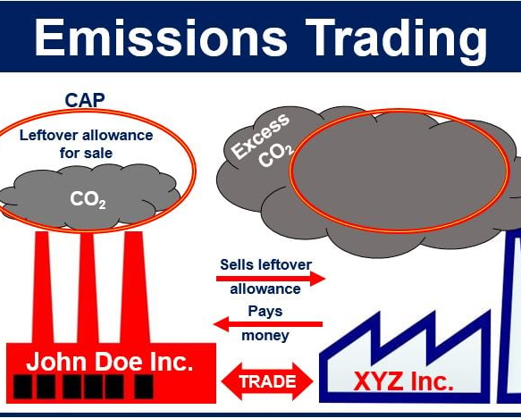
CARBON MARKET-emissions
CO2 emissions occur when carbon dioxide released into the atmosphere. Human activities and natural processes release the gas.
Earth has natural processes that remove carbon from the atmosphere . These processes keep the naturally-emitted CO2 level stable. EX:- plant & animal respiration.
Earth cannot remove the carbon emission that human activities caused. As CO2 absorb infrared radiation and trap heats as it travel upwards away from earth towards space.
If we fall to stop CO2 levels from rising ,global warming will accelerate.

Slide 10
CARBON MARKET-offsetting
Carbon offsetting is the process by which companies and households can compensate for the release of greenhouse gas GHG emissions.
Households and companies do this by funding certified GHG reduction projects. These projects either destroy the emissions or sequestrate CO₂. They also fund projects that prevent emissions elsewhere.
A carbon credit is a financial unit of measurement. It represents the removal of one tCO₂e from the atmosphere. tCO₂e stands for ton of carbon dioxide equivalent.
Carbon credits come from successful greenhouse-gas-emission reduction projects. In other words, projects that deliver reductions in emissions. They reduce emission by either replacing the use of fossil fuels with renewable energy or reducing fossil fuel usage through energy efficiency.
Renewable energy is energy whose source lasts for ever; it never runs out. We could never use it all up.
Carbon credits also come from capturing and storing released carbon in plants.

Slide 11
ROLE OF AI CARBON MARKETING
AI can reduce emissions by forecasting future carbon emissions based on current data on carbon footprint . It can also develop low-emission infrastructure and model climate change predictions.
Artificial intelligence (AI) can be used to deliver deep insights into multiple aspects of a company’s carbon footprint and quick cost-cutting wins offers a promising route to accelerating sustainable transformation and reducing expenses in a time of need.
AI has the potential to reduce companies’ greenhouse gas emissions and cut costs by monitoring their carbon footprint and then reducing it through increased efficiency .Industries that can benefit from this approach include industrial goods , transportation , pharmaceutical , energy & utilities.
Companies can use AI-powered data engineering to automatic track emissions throughout their carbon footprint. Predictive AI can forecast future emissions across a company’s carbon footprint, in relation to current reduction efforts, new carbon reduction methodologies, and future demand. As a result , they can set , adjust and achieve reduction targets more accurately.

Slide 12
CONTINUED….
In fact, using AI can achieve 5% to 10% of the needed reduction in greenhouse gas emissions. Accomplishing a low carbon future will require more efficient operations that help increase productivity and reduce waste.
Meanwhile, BCG studies show that the potential overall impact of applying AI to corporate sustainability amounts to $1.3 trillion to $2.6 trillion in value generated through additional revenues and cost savings by 2030.

Slide 13
IMPLEMENTING AI FOR REDUCING EMISSIONS
CHALLENGES :- One of the challenges is the difficulty and expense of measuring the full extent of carbon emissions and then reducing or offsetting them. Another challenge is that AI models can be energy-intensive and can generate high volumes of climate-changing carbon emissions.
COMPANIES CAN OVERCOME THE CHALLENGE OF MEASURING CARBON EMISSIONS :- Companies can leverage AI-supported tools to automatically ingest and report data, calculate a carbon footprint, run simulations, set targets, manage a global portfolio of abatement initiatives, and more. Implementing new AI-supported tools can help take companies to the next level of measurement and tracking. Our experience suggests that AI can directly enable the reduction of companies’ emissions by as much as 40% through identifying the best initiatives, tracking results, and optimizing operations.

Slide 14
COMPANIES CAN REDUCE CARBON FOOTPRINT
Measure your carbon footprint derived from your business activities, in order to know where you stand and which are the areas to prioritize. Many tools are available today for organizations to calculate the total greenhouse gas emissions they generate.
Move toward zero waste. The current way we conduct business — that is, through production, transportation, and consumption — is inherently wasteful. By moving toward zero waste, businesses can reduce their carbon footprint.
Harness renewable energy sources. Renewable fuels have become more prevalent over the last several years, largely due to the fact that they’re more cost-effective than traditional fossil fuels.
Cut business travel. Business travel is one of the biggest contributors to a company’s carbon footprint. By cutting back on travel and using video conferencing instead, businesses can reduce their carbon footprint.
Recycling paper can help reduce carbon footprint by reducing the amount of waste that goes to landfills. When paper decomposes in landfills, it releases methane, a potent greenhouse gas.
Reducing air travel can help reduce carbon footprint by reducing the amount of greenhouse gases emitted by airplanes. Airplanes emit large amounts of carbon dioxide and other greenhouse gases into the atmosphere.

Slide 15
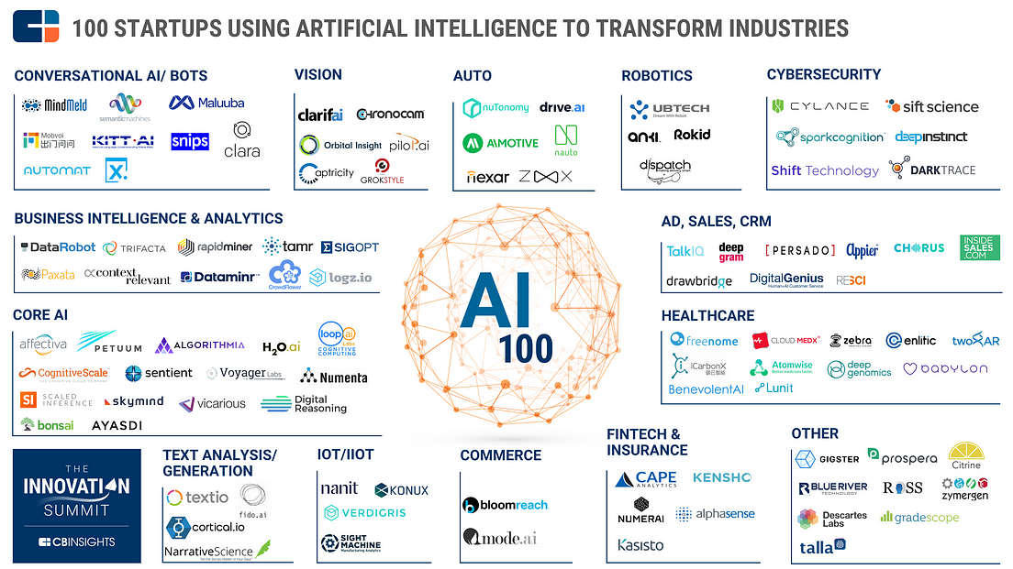
COMPANIES USING AI FOR SUSTAINABILITY
1.Google’s DeepMind division has developed AI that teaches itself to minimize the use of energy to cool Google’s data centre . As a result, Google reduced its data centre energy requirements by 35%.
2. IBM is using AI for better weather forecasting , making their predictions 30% more accurate.
3. AEGIS AI , IC Realtime and IBM’s Tririga are companies that can help optimize energy use in buildings by tracking no. of people in a room or predicting the availability of renewable energy resources.
4.IBM recently unveiled its 5 in 5 climate & environmental research initiative, pledging to dedicate technology , talent , and resources to enable a more sustainable future.

Slide 16

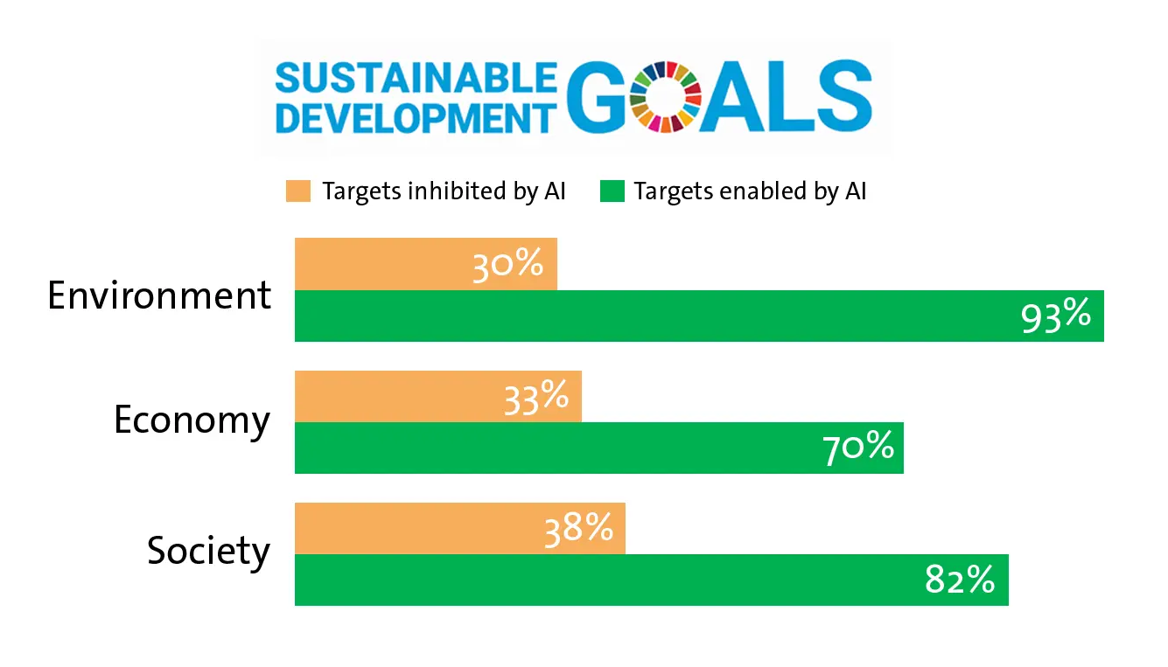
….☺

Slide 17
TOP 5 COMPANIES USING AI TO COMBAT CLIMATE CHANGE
IBM :- One of the company’s main goals is to utilize AI to simulate a method of converting atmospheric nitrogen into fertilizer, which helps increase sustainable agriculture growth. Also, IBM’s Green Horizons initiative works to make cities greener, and has incorporated AI to predict when pollution levels are likely to rise and to protect people from it.
INTEL :- On Earth Day, Intel partnered with Accenture and Sulubaai Environmental Foundation to announce project CORaiL; an artificial intelligence solution to monitoring and analyzing coral reefs. On top of that, Intel has launched a large-scale water restoration project, a wildlife research project that uses AI to help researchers track polar bear behavior patterns, and the AI For Social Good Program, which seeks to positively impact Earth, society, and global health.
FACEBOOK :- Teaming with researchers from Carnegie Mellon University, Facebook recently launched the Open Catalyst Project, in an effort to address climate change through artificial intelligence. The project’s goal is to find new “electrocatalysts” to convert wind and solar power into other fuels easy to store. Researchers can currently only test tens of thousands of catalysts, but through machine learning, Facebook hopes to create millions if not billions of these catalysts, which will be very effective in combating climate change.

Slide 18

CONTINUED…..
4.GOOGLE :- Working with DeepMind, a Google-owned AI and research company, Google applied machine learning algorithms to reduce the amount of energy from their numerous data centers by 40% on top of investing in green energy sources. On a larger scale, this helps other companies who rely on Google’s cloud to reduce their energy emissions as well, setting a sustainable precedent for other companies to follow. With the goal of reaching carbon neutrality by 2030, Google has also vowed to stop making custom AI and ML tools for large oil firms.
5.MICROSOFT :- Microsoft’s AI for Earth Program provides Microsoft’s cloud and Artificial Intelligence tools for scientists and researchers working to combat climate change. Microsoft’s Cloud Agronomics Project uses AI to provide crop growers with crop and soil insights, leading to more sustainable and efficient food production. While Microsoft is receiving heavy criticism for providing AI and machine learning tools for companies in the fossil fuel industry, Microsoft recently announced its goal to be carbon negative by 2030.

Slide 19
Looking forward to the future, it is essential that more companies utilize their technological capabilities to combat climate change and prevent irreversible changes that will last for future generations to come. It is fascinating to see the possibilities of how AI can positively affect our environment, and hopefully more and more companies will contribute.
-------------------------------------------------------------------------------------------------------------------------------
The carbon emission prediction model relies on converting energy data, whether directly or indirectly, to estimate carbon emissions. This approach not only helps us understand the impact of energy consumption on the environment, but it also has the potential to drive innovation in the energy sector.
Predicting CO2 emission using machine learning
IJREAMSSJ2218.pdf
s42256-022-00529-w.pdf
Carbon dioxide prediction using support vector machine
pdf (iop.org)
-------------------------------------------------------------------------------------------------------------------------------------

Slide 20
Related References :-
Role of AI in carbon marketing :-
Reduce Carbon and Costs with the Power of AI | BCG
The Role Of AI In Carbon Reduction And Increased Efficiency For Energy (forbes.com)
Use of AI to measure emissions:-
Measuring Emissions Accurately | BCG
AI to measure emission accurately.pdf
AI growing carbon footprint:-
AI’s Growing Carbon Footprint (columbia.edu)
AI’s Carbon Footprint Problem (stanford.edu)

Slide 21
….continued
How to make ai greener
How to Make Generative AI Greener (hbr.org)
How to reduce ai carbon footprint as a data scientist.
How to Reduce the AI Carbon Footprint as a Data Scientist (statworx.com)
Reducing Carbon Emissions With AI And Smart Building Technology – Spiceworks
AI for good: how we’re reducing carbon emissions and using AI to fight climate change - Faculty

